Slide 1

Iteration Method
Nav Sanya Anand

Slide 2


Steps to follow and Points to Note
Convert the recurrence into a summation and try to bound it using known series.
Point to note:
Assume $n=2^{k}$

Slide 3
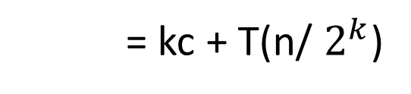
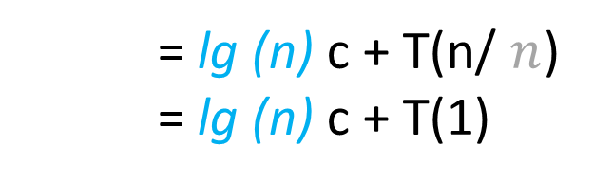
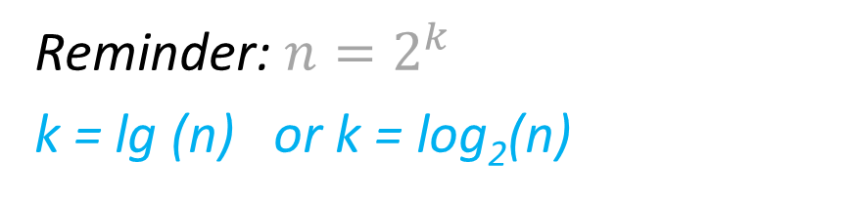
Example 1 - T(n) = c + T(n/2)
T(n) = c + T(n/2)
= c + (c + T(n/4))
= 2c + T(n/4)
T(n/2) = c + T(n/4)
= 2c +(c + T(n/8))
= 3c + T(n/8)
.
.
.
T(n/4) = c + T(n/8)
= kc + T(n/ $2^{k}$)
Reminder: $n=2^{k}$
k = lg (n) or k = log₂(n)
= lg (n) c + T(n/ $n$)
= lg (n) c + T(1)
Θ(lg (n))

Slide 4
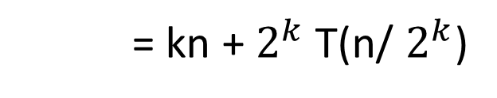
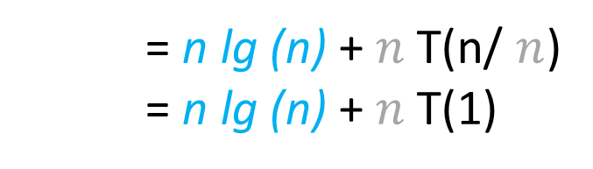
Example 2 - T(n) = n + 2T(n/2)
T(n) = n + 2T(n/2)
= n + 2(n/2 + 2T(n/4))
= 2n + 4T(n/4)
T(n/2) = n/2 + 2T(n/4)
= 2n + 4(n/4 + 2T(n/8))
= 3n + 8T(n/8)
.
.
.
T(n/4) = n/4 + 2T(n/8)
= kn + $2^{k}$T(n/ $2^{k}$)
Reminder: $n=2^{k}$
k = lg (n) or k = log₂(n)
= n lg (n) + $n$T(n/ $n$)
= n lg (n) + $n$T(1)
Θ(n lg (n))

Slide 5
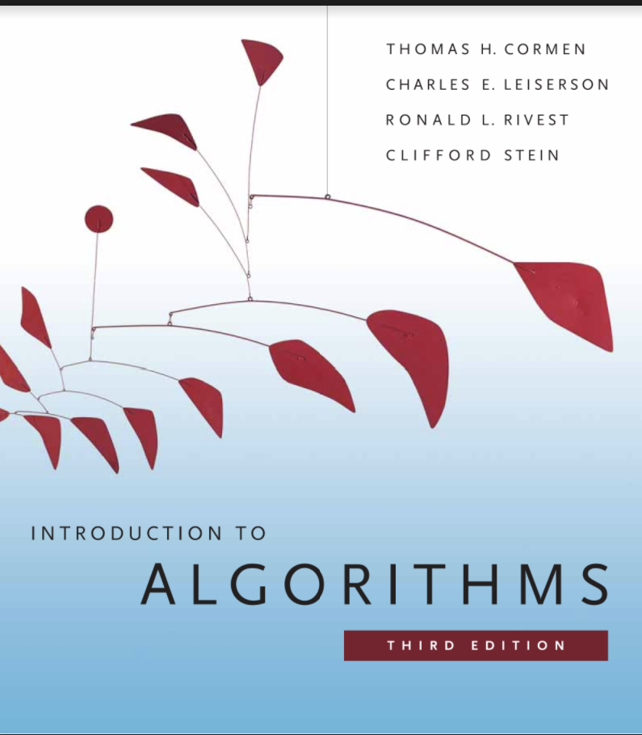
References

